Slide 1

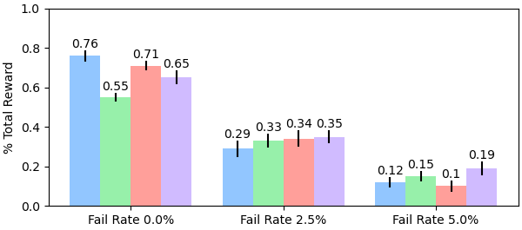
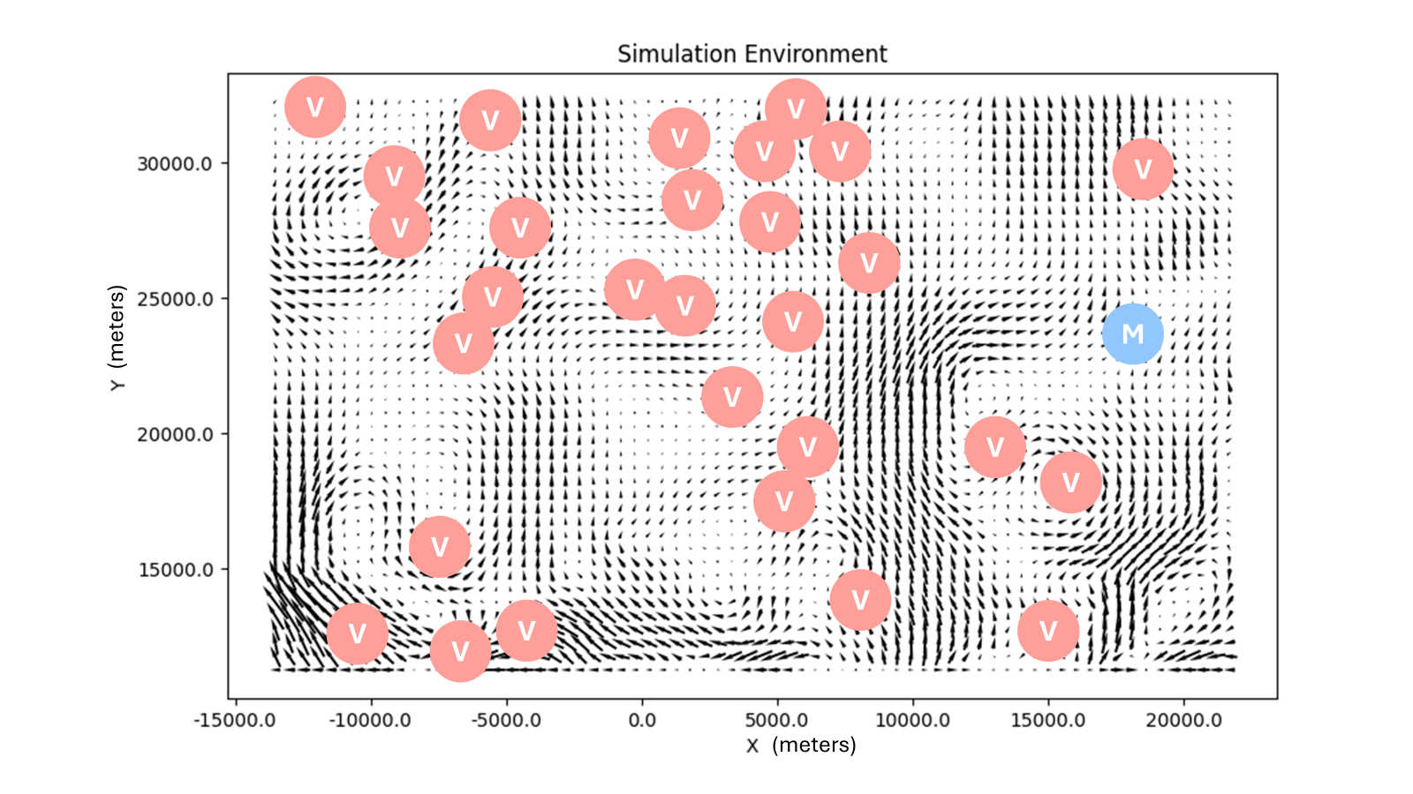
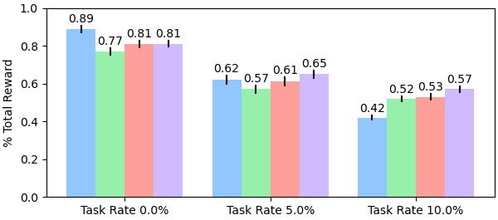


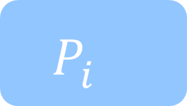
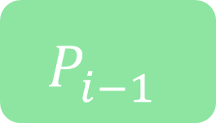
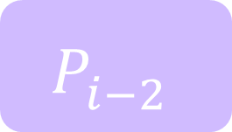
NSF Award
#2322055
Hybrid Decentralization for Multi-Robot Orienteering with Mothership-Passenger Systems
Nathan L. Butler and Geoffrey A. Hollinger
Collaborative Robotics and Intelligent Systems (CoRIS) Institute, Oregon State University
Multi-robot teams are useful for efficiently exploring isolated, hazardous environments.
If reaching the environment is itself a hazardous task, a larger mothership robot can be used to first transport the team to regions of interest.
Once the team has been deployed, passengers must solve a challenging Stochastic Multiagent Orienteering Problem to allocate tasks, plan paths, and return to the mothership for extraction within battery limits.
Opportunity: How can we leverage a hybrid centralized-decentralized network available in Mothership-Passenger systems to solve complex orienteering problems?
Hybrid Decentralized Mission Planning
We inject plans developed by a powerful centralized planner onboard the mothership into passengers’ decentralized planning routines to improve system-level coordination.
Aggregate observations from connected passengers.
Use centralized solver to compute joint team plans.
Receive candidate plan distributions from neighbors.
Solve & evaluate plans by sampling from neighbor distributions.
Share highest-performing distribution of local plans with neighbors.
Mothership shares joint solutions with connected passengers.
Passengers process received plan with local solutions.
Passengers store history of high-value plans to maintain consideration for mothership solutions.
Mothership
Passenger i
Centralized Solver
Stored Plans
Decentralized Solver
Neighboring Robots
$$P_{i−2}^{}$$
$$P_{i−1}^{}$$
$$P_{i}^{}$$
Plan Valuation & Selection
Candidate Plans
Hybrid Decentralized Mission Planning
We evaluate our framework in a simulated underwater environment.
Tasks (V) and the mothership location (M) are distributed randomly.
Ocean currents from high-fidelity underwater simulator provide stochastic travel times.
We compare four algorithmic variants:
Initial, centralized solution only (Sim-BRVNS [X])
Decentralized planning only (Dec-MCTS [X])
Initial + decentralized replanning (2-Stage)
Initial + hybrid replanning (2-Stage Hybrid)
We inject disturbances (robot failures, new tasks) into the system to evaluate each method’s replanning performance.
3 Robots, 30 Tasks
6 Robots, 20 Tasks
Our hybrid planning framework offers an initial performance boost from the mothership’s centralized solver. Once deployed, the mothership improves system-level coordination in the presence of disturbances.
butlnath@oregonstate.edu
natbut.github.io
QR TO WEBSITE PAPER

Slide 2
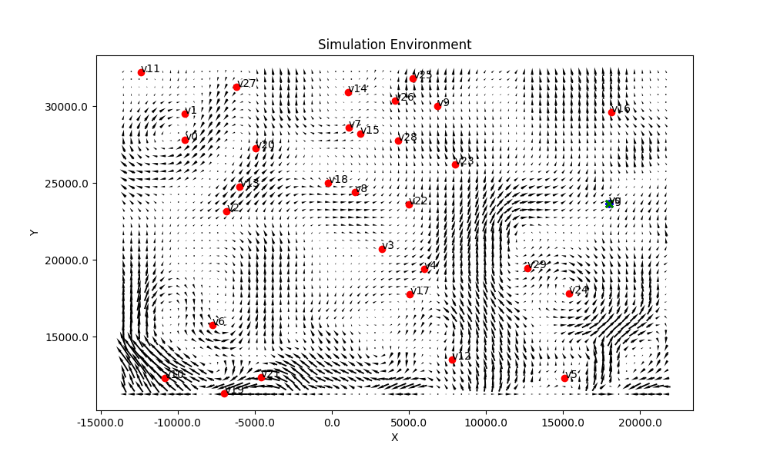
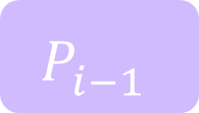
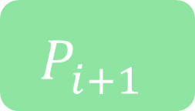
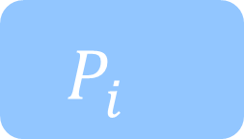
NSF Award
#2322055
Hybrid Decentralization for Multi-Robot Orienteering with Mothership-Passenger Systems
Nathan L. Butler and Geoffrey A. Hollinger
Collaborative Robotics and Intelligent Systems (CoRIS) Institute, Oregon State University
Multi-robot teams are useful for efficiently exploring isolated, hazardous environments.
If reaching the environment is itself a hazardous task, a larger mothership robot can be used to first transport the team to regions of interest.
Once the team is deployed, passengers must solve a challenging Stochastic Multiagent Orienteering Problem to allocate tasks, plan paths, and return to the mothership for extraction within battery limits in a stochastic environment.
Opportunity: How can we leverage a hybrid centralized-decentralized network available in Mothership-Passenger systems to solve complex orienteering problems?
Marine under-ice mission planning
Hybrid Decentralized Mission Planning
We inject plans developed by a powerful centralized planner onboard the mothership into passengers’ decentralized planning routines to improve system-level coordination.
Mothership
Mothership
Aggregate observations from connected passengers.
Use centralized solver to compute joint team plans.
Share solutions with connected passengers.
Centralized Solver
$$P_{i−1}^{}$$
$$P_{i}^{}$$
$$P_{i+1}^{}$$
Passenger i
Solve local plan using observations & candidate plans from neighbors.
Evaluate new plans against history of high-value solutions (both solved locally & received from mothership).
Store & share distribution of high-value plans.
Stored Plans
Decentralized Solver
Plan Valuation & Selection
Passengers’ decentralized planning routine supports coordination with neighbors in communication range. Plans received from the mothership align passenger actions with distant robots as well.
Candidate Plans
Neighboring Robots
Experiments and Results
We evaluate our framework in a simulated underwater environment.
Tasks (V) and the mothership location (M) are distributed randomly.
Ocean currents from high-fidelity underwater simulator provide stochastic travel times.
We compare four algorithmic variants:
Initial, centralized solution only
Decentralized planning only
Initial + decentralized replanning
Initial + hybrid replanning
We inject disturbances (robot failures, new tasks) at specified rates into the system.
These disturbances introduce heterogeneity in team observations and allow us to evaluate each methods’ performance in replanning.
3 Robots, 30 Tasks
6 Robots, 20 Tasks
Our hybrid planning framework offers an initial performance boost from the mothership’s centralized solver. Global coordination provided by the mothership improves system robustness in high-disturbance scenarios.
butlnath@oregonstate.edu
natbut.github.io
QR TO WEBSITE PAPER

Slide 3
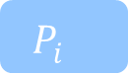
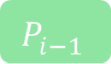
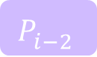
Mothership
Mothership
Mothership
Passenger i
Centralized Solver
Stored Plans
Decentralized Solver
Neighboring Robots
$$P_{i−2}^{}$$
$$P_{i−1}^{}$$
$$P_{i}^{}$$
Plan Valuation & Selection
Candidate Plans

